Slide 1
DAY 1 Tasks
Computer Hardware Components
Write a Pseudocode and draw a Flowchart to find the greatest of 3 numbers?
By – Lakshita Garg

Slide 2

Computer Hardware Components

Slide 3
COMPONENTS
Input Devices
Output Devices
Memory Devices
ALU
CPU
Secondary Storage

Slide 4
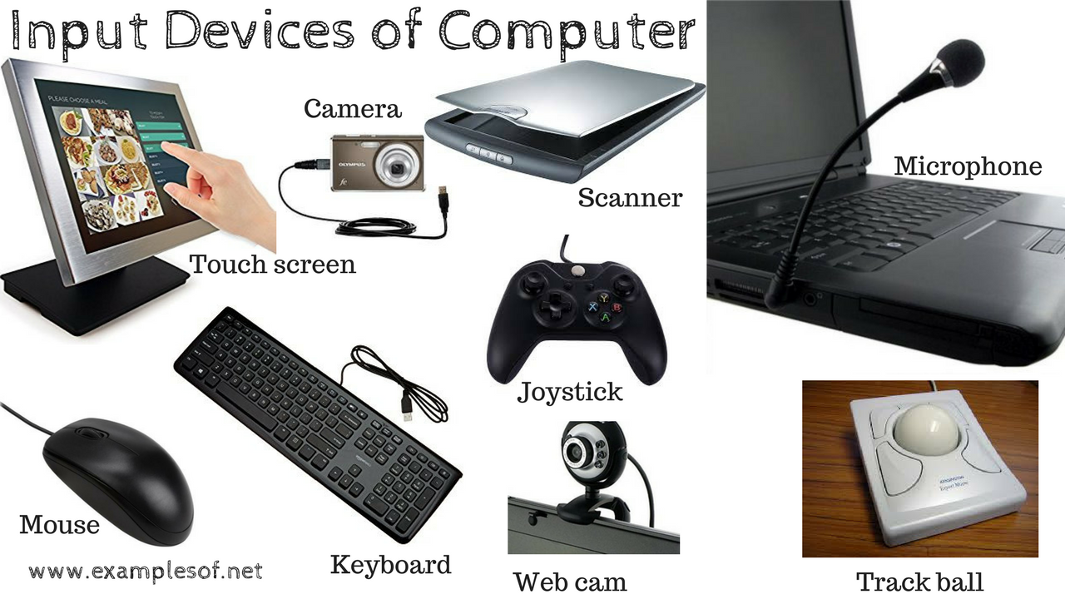
Input Devices
Hardware used to enter data and instructions.

Slide 5
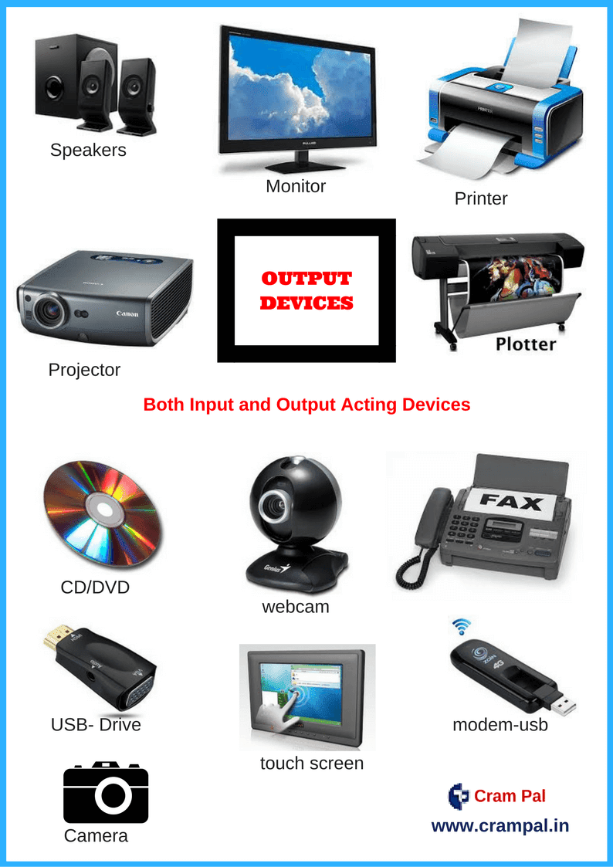
Output Devices
Hardware that conveys information to the user.

Slide 6
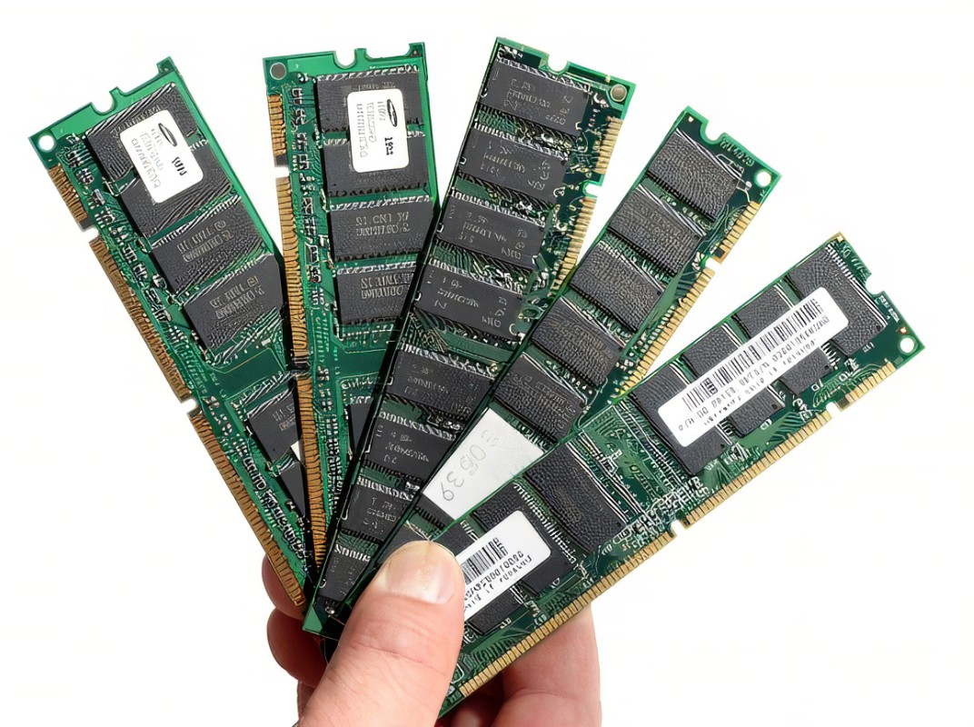
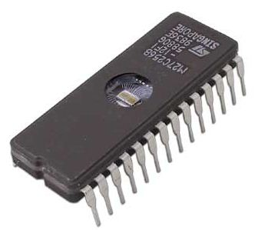
Memory Devices
RANDOM ACCESS MEMORY (RAM)
Temporary storage for data and programs that are being accessed by the CPU.
Volatile in nature.
READ ONLY MEMORY (ROM)
Type of memory that can only be read unlike RAM which can be both read and written.
Non-volatile in nature.

Slide 7
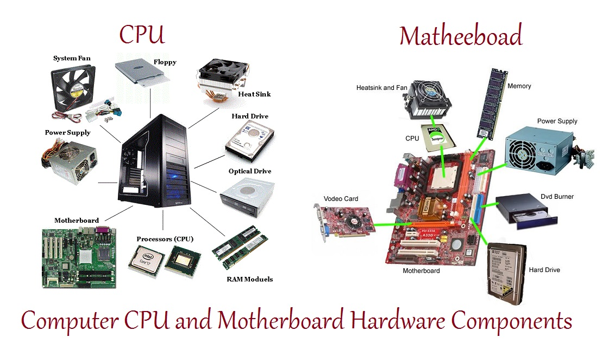
Computer Processing Unit (CPU)
Brain of the Computer.
Controls the data transfer between memory and other devices.
Consists of two smaller units: 1. Control Unit (CU) 2. Arithmetic Logic Unit (ALU)

Slide 8
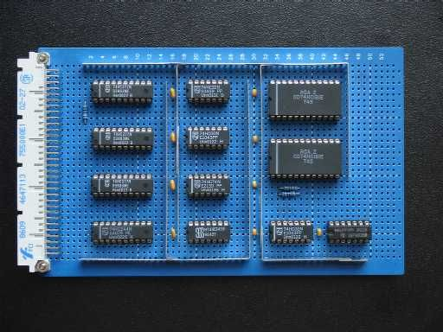
Arithmetic and Logic Unit (ALU)
Performs arithmetic operations such as Addition, Subtraction, Multiplication, Division etc.
Performs logical operations such as Reasoning and Performing the comparisons necessary for decision making.

Slide 9
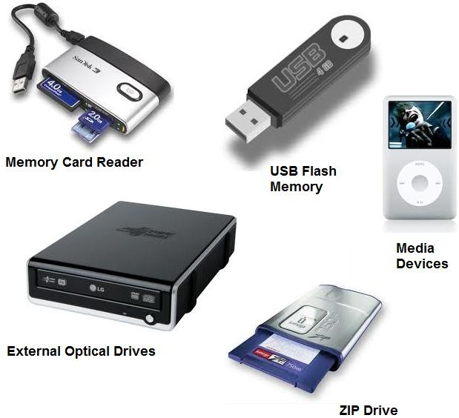
Secondary Storage
Also referred to as backing storage or auxiliary storage.
Refers to media and methods used to keep programs, data and information available for later retrieval.
Not built on chips. Some examples are: - Hard Disks - Floppy Disks - Magnetic Tape - Microfilms - CD’s/DVD’s

Slide 10
PSEUDOCODE
PROBLEM STATEMENT – Find the greatest number among 3 given numbers.
Start
Declare variables a, b, c.
Read variables a, b, c.
If a>b: If a>c: Display a is the greatest number. Else If b>c: Display b is the greatest number. Else: Display c is the greatest number.
Stop

Slide 11
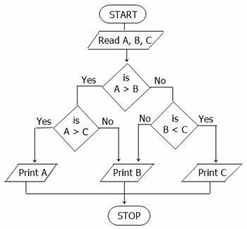
FLOWCHART
PROBLEM STATEMENT – Find the greatest number among 3 given numbers.

